Slide 1

Hotel Booking Management System
Submitted To-
Mahfujur Rahman
Lecturer, Computer Science
Submitted By-
SL No | Student Name | Student ID
01 | Saiydur Rahman | 19-39890-1
02 | JIHAD SHAHARIAR JOY | 19-40068-1
03 | ASHFAT AL RASHID | 19-40195-1
04 | MD. MAHINUR RAHMAN | 19-40226-1
05 | MD. RAZIB MOLLAH | 20-42153-1

Slide 2
Outlines
Introduction
Motivation
Diagrams
Achievements
Conclusion

Slide 3
Introduction
Most of the hotel are using manual system for booking or reservation.
Where all booking details are recorded in a handwritten file.
Calculation of bills and inventory items are also done by manually.
As the current system is a file based on, management of the hotel must put much effort on security those files. Also, it can be damaged day by day.
More than 1million people are visited hotel and each hotel has more than 500 people which is difficult to manage their guests.
Billing system is also poor because they only accepted cash which is hassle for a guest/tourist.

Slide 4
Motivation
We decide to develop a software-based Hotel Booking Management System to give quick service for guest.
Computerized system replaces the manual booking system
This system is hassle-free for guest and hotel manager to give them service and other utilities.
Guest can check their room by phone and check that the room is available or not.
Building super safe and secure file system which is cloud database system.
Give users a friendly booking system environment

Slide 5
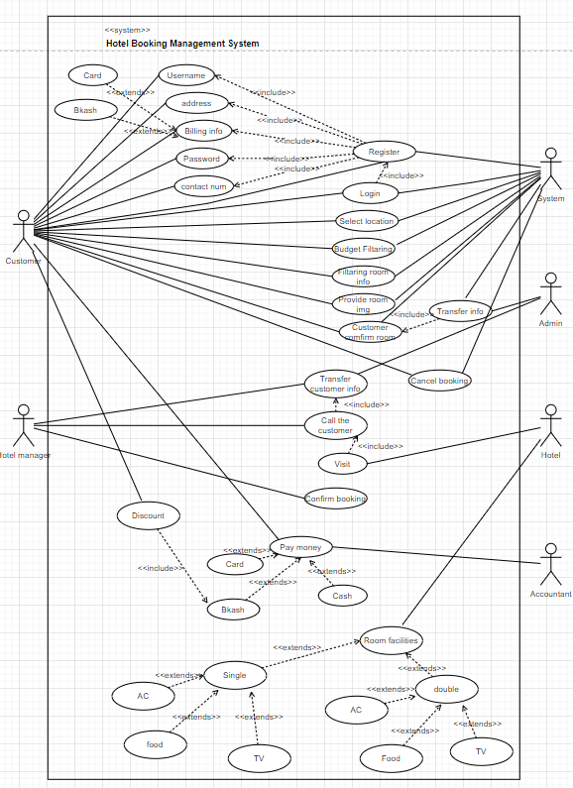
Use Case Diagram

Slide 6
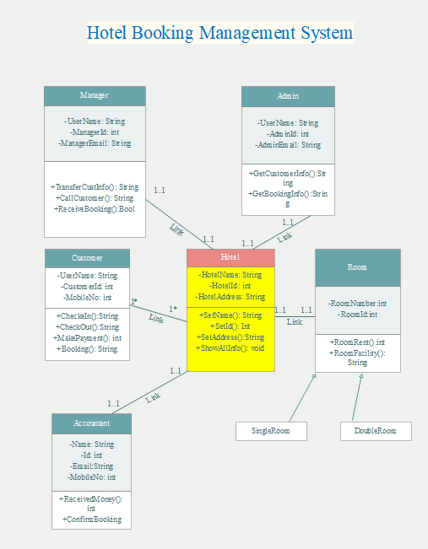
Class Diagram

Slide 7
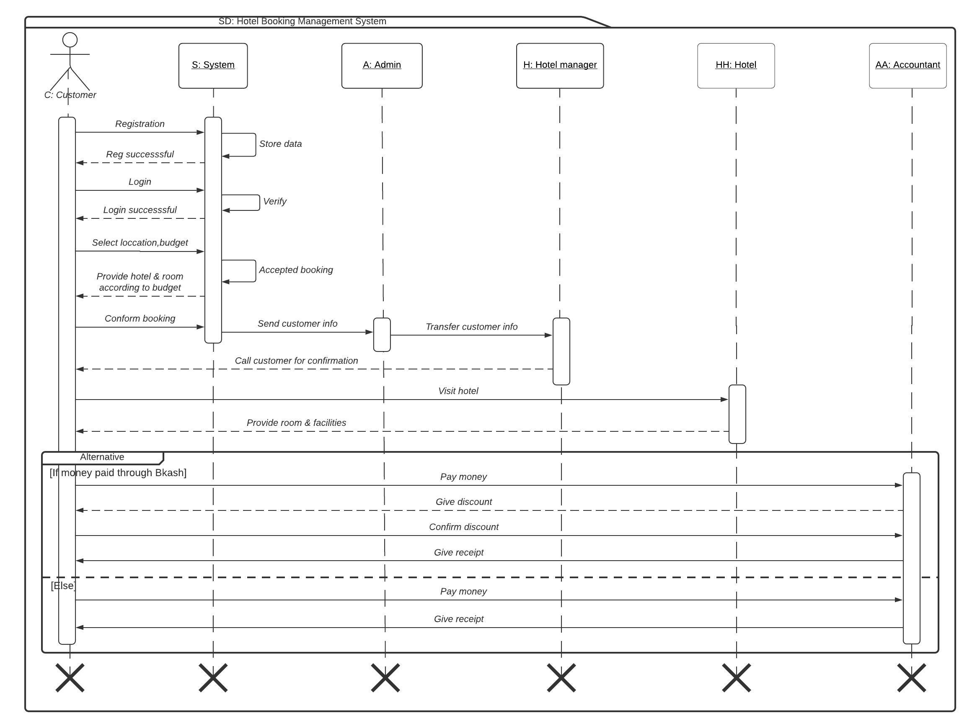
Sequence Diagram

Slide 8
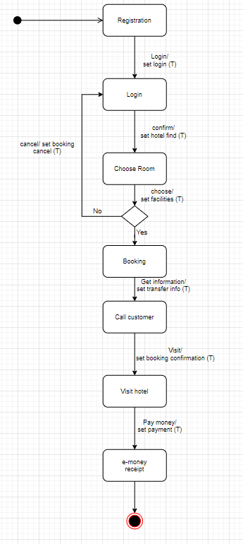
State Chart Diagram

Slide 9
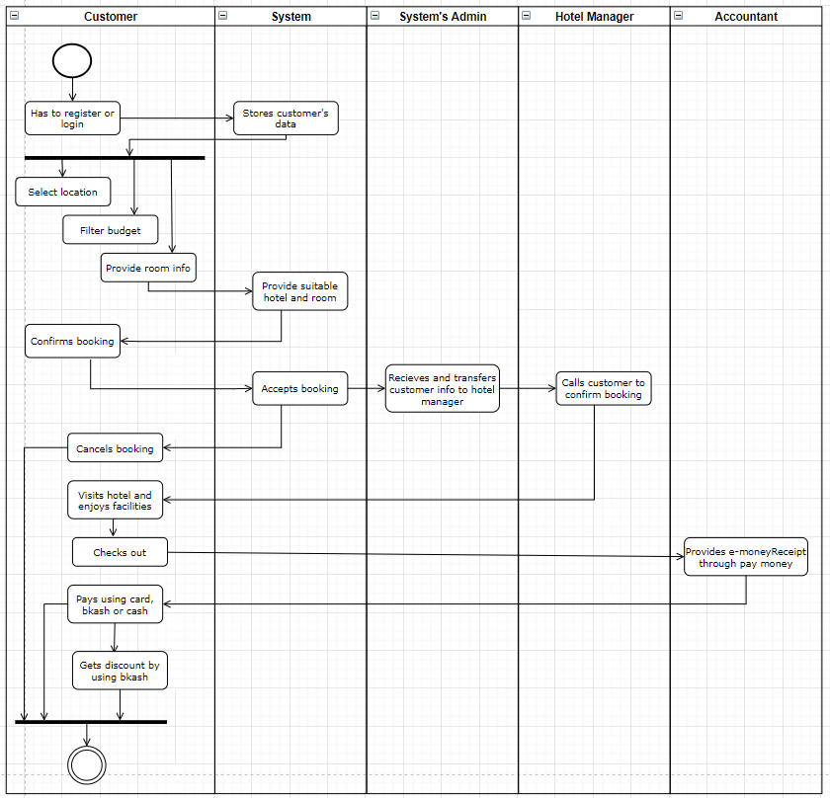
Activity Diagram

Slide 10
Achievements
Computerized system replaces to the manual booking system.
Save time wasting hotel employees and guests.
Develop database which stored guest details when they entered their details.
Create and easy to understand user friendly environment.
Guest can get speed registration service.
No hassle for payment.
24/7 Services with less stuff.
Low cost with best affordability.

Slide 11
Conclusion
We are trying to give a best solution for this problematic situation and hope this is the best solution for every hotel, and they should implement this software on there hotel because after this software they need less stuff, and they can give 24/7-hour facilities. User have good affordability, changes and cancellation, details about hotel, room details, discount deals by using this software. The best thing is no mistake with bill calculation and hassle-free payment.

Slide 12
Thank You ☺

